Slide 1
Taxonomy of the Tax Program
Lake County Property Assessment Screens - 2018

Slide 2
Screen Scraping Lake County Tax Data
Overview:
Fighting your property taxes is an intimidating endeavor that most simply won’t take the time to do. Lake County has now requires that only the home owner or a licensed attorney can challenge the tax assessment for a property. This puts the responsibility on the homeowner to fight on their own or incur expensive attorney fees to reduce their taxes.
Some people have fought their taxes on the basis of equity or sales comparison and have successfully reduced their taxes. However, there are many properties that have continually increased in the “assessed value” despite market conditions reducing the property value resulting in the home owner being over taxed.
By collecting the property characteristics and the tax assessment data for each property we can programmatically analyze the data on a large scale to evaluate how “fair” the tax assessment is for the property.

Slide 3
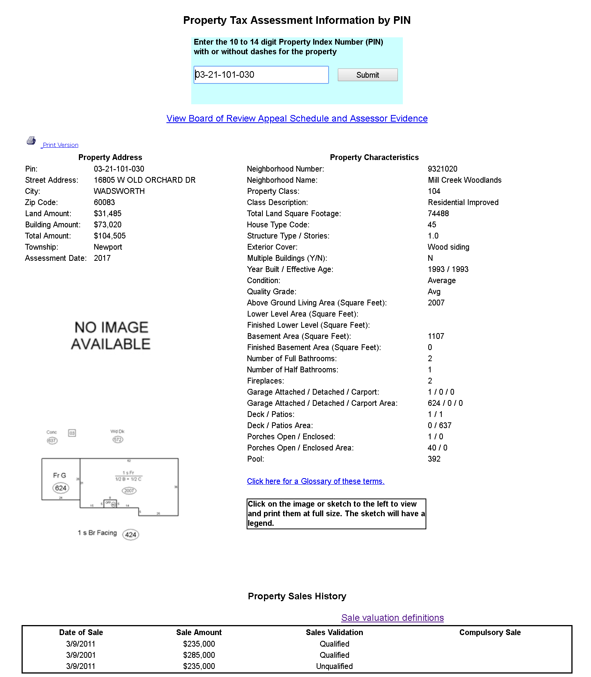
Property Summary Screen
PropertySummary.py
http://apps01.lakecountyil.gov/spassessor/comparables/PTAIpin.aspx?PIN=’ + PIN#
Output File: PropertySummary_Data.txt
Field Labels:
PIN, City, ZipCode, Township, Assessment Date, Property Class, Class Description, Multiple Buildings
Sample Output:
0301300006|WADSWORTH|60099|Newport|2017|118|Farm Land|N
0301300008|ZION|60099|Newport|2017|181|Farm Homesite w/acres|N
0301300016|ZION|60099|Newport|2017|104|Residential Improved|N
Output File: PropertySalesHistory.txt
Field Labels: PIN, Date of Sale, Sales Amount, Sales Validation, Compulsary Sale
Sample Output:
0302300006|8-7-2006|44900|Qualified|
0302300008|12-1-1998|8000|Unqualified|
0302400041|8-22-2012|388800|Not validated|
0302300012|7-22-2016|60725|Unqualified|Foreclosure
Program Execution:
C:\Users\Joe Rytting\Documents\Python Example Code\TaxProject\PropertySummary>python PropertySummary.py
Working from file: 1000TestPins.txt 2018-08-02 21:55:25.038439
#-------------------------------------------------------------------
# Program Statistics
#-------------------------------------------------------------------
Program execution time in Seconds: 314.216752 Records/Second: 0.31
Program wrote the folliwing lines: 1000
Records read from File: 1000TestPins.txt : 1000
Records written to Data File: PropertySummary_Data.txt : 985
Sales Records written to Data File:PropertySalesHistory.txt : 644
Records written to Error File: PropertySummary_Error.txt : 15
Internet Connection Errors : 0

Slide 4
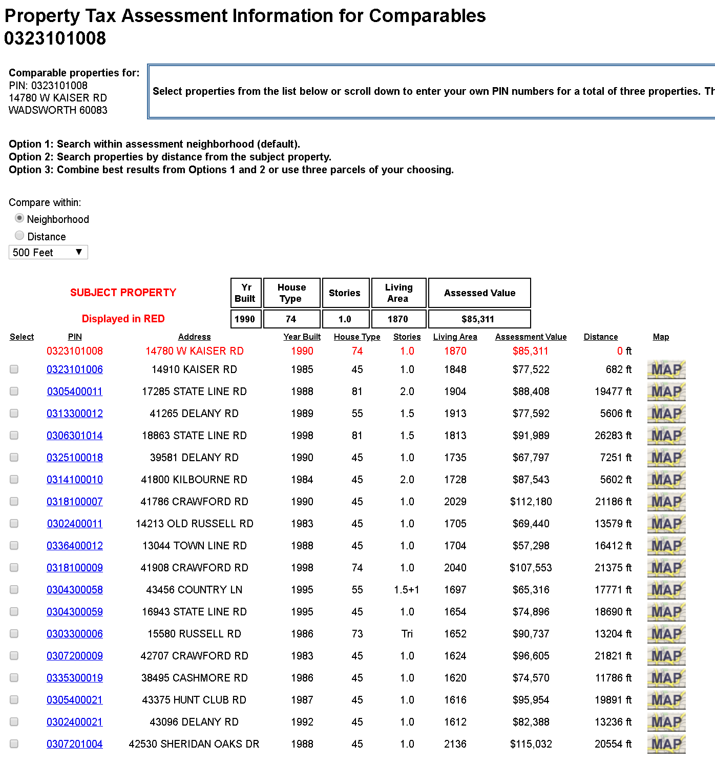
Property Comparison by Equity Screen
CompPropEquity.py
https://apps03.lakecountyil.gov/comparables/PTAIPicker.aspx?PIN=‘+ PIN# + '&TYPE=A&POPUP=Y
Output File: CompPropEquity_Data.txt
Field Labels:
PIN, Distance, Comp Pin, ”EQUITY”
Sample Output:
0323101008|682|0323101006|EQUITY|
0323101008|19477|0305400011|EQUITY|
0323101008|5606|0313300012|EQUITY|
Output File: CompPropEquity_Error.txt
Error Message Output:
No Properties Match Criteria for :0309400039
No Properties Match Criteria for :0309400040
Invalid Pin : 0310100004
Invalid Pin : 0310100005
Program Execution:
C:\Users\Joe Rytting\Documents\Python Example Code\TaxProject\CompsByNeighborhood>python CompPropEquity.py
Working from file: 1000TestPins.txt
#-------------------------------------------------------------------
# Program Statistics
#-------------------------------------------------------------------
Program execution time in Seconds: 226.636055 Records/Second : 0.23
Records read from File: 1000TestPins.txt : 1000
Records written to Data File: CompPropEquity_Data.txt : 8401
Records written to Error File: CompPropEquity_Error.txt : 446
Internet Connection Errors : 0

Slide 5
Property Comparison by Recent Sales Screen
CompSales.py
https://apps03.lakecountyil.gov/comparables/PTAIPicker.aspx?PIN=+PIN# +&TYPE=S&POPUP=Y
Output File: CompPropBySales_Data.txt
Field Labels:
PIN, Distance, Comp Pin, ”SALES”
Sample Output:
0313300028|3834|0418100011|SALES|
0407302001|1302|0407406029|SALES|
0407302001|1284|0407402008|SALES|
0407302001|1536|0407402018|SALES|
0407302001|1592|0407402019|SALES|
0407302001|1643|0407402020|SALES|
Program Execution:
C:\Users\Joe Rytting\Documents\Python Example Code\TaxProject\CompsBySales>python Compsales.py
Working from file: 1000TestPins.txt
2018-08-02 21:32:04.065342
#-------------------------------------------------------------------
# Program Statistics
#-------------------------------------------------------------------
Program execution time in Seconds: 332.663912 Records/Second: 0.33
Records read from File: 1000TestPins.txt : 1000
Records written to Data File: CompPropBySales_Data.txt : 27075
Records written to Error File: CompPropBySales_Error.txt : 0
Internet Connection Errors : 0

Slide 6
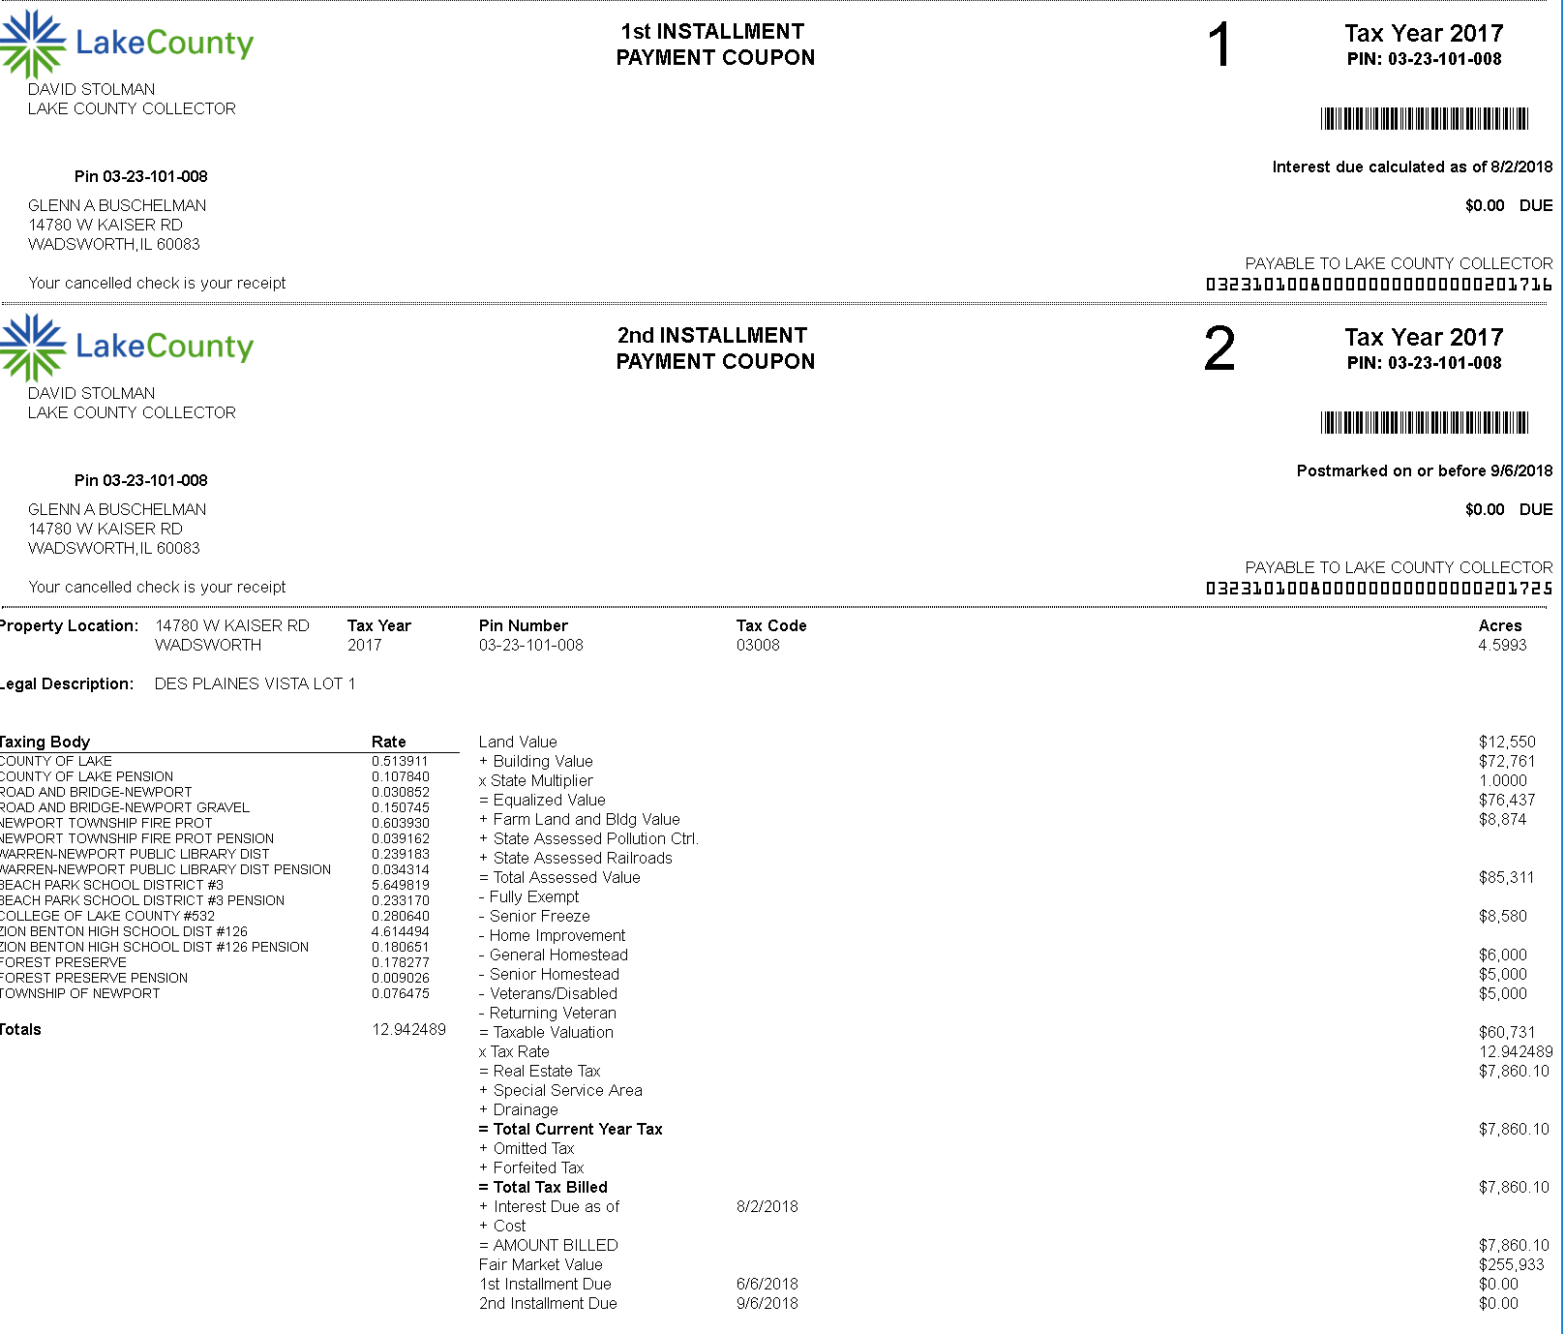
Property Tax Bill Screen
Field Labels:
'pin': '#',
'tax_year': '#',
'tax_payers_name': '#',
'tax_payers_street_address': '#
'tax_payers_city': '#',
'tax_payers_state': '#',
'tax_payers_zipcode': '#',
'legal_description1': '#',
'legal_description2': '#',
'land_value': '#',
'building_value': '#',
'state_multiplier': '#',
'equalized_value': '#',
'farm_land_and_bldg_value': '#'
'state_assessed_pollution_ctrl'
'state_assessed_railroads': '#'
'total_assessed_value': '#',
'fully_exempt': '#',
'senior_freeze': '#',
'home_improvement': '#',
'limited_homestead': '#',
'senior_homestead': '#',
'veterans_disabled': '#',
'returning_veteran': '#',
'taxable_valuations': '#',
'tax_rate': '#',
'real_estate_tax': '#',
'special_assessment': '#',
'drainage': '#',
'total_current_year_tax': '#',
'omitted_tax': '#',
'forfeited_tax': '#',
'total_tax_billed': '#',
'interest_due_as_of_date': '#',
'interest_due': '#',
'cost': '#',
'amount_billed': '#',
'fair_market_value': '#',
'special_notes1': '#',
'special_notes2': '#',
'special_notes3': '#',
'special_notes4': '#',
'special_notes5': '#',
'special_notes6': '#',
'special_notes7': '#',
'first_installment_due': '#',
'first_installment_amt': '#',
'second_installment_due': '#',
'second_installment_amt': '#'}
TaxBill.py
https://apps03.lakecountyil.gov/treasurer/collbook/collbook4.asp?PIN=' + pinToUse + '&unit=0000'
Output File: TaxBill_Data.txt
Field Labels:
Sample Output: (Output from 1 record)
0301300008|2017|C EARL; JANTZI;|3751 ROCKFISH RD|GROTTOES|VA|24441|PT GOVT LOT 1 W1/2 FRCL BEG 4.5 CHS N OF SW COR N443' N 77DEG32 MIN 30 SEC E TO A LN THAT IS |// TO & 10.35 CHS E OF W LN S TO A PNT THAT IS N 74 DEG 30 MIN E OF POB SW TO POB|18217|52720|1.0000|70058|879|0|0|70937|0|0|0|0|0|0|0|70937|12.668992|8987.00|0|0|8987.00|0|0|8987.00|8-2-2018||0|8987.00|212811|#|#|#|#|#|#|#|6-6-2018|0.00|9-6-2018|4493.50|
Program Execution:
C:\Users\Joe Rytting\Documents\Python Example Code\TaxProject\DetailedTaxBill>python taxBill.py
Working from file: 1000TestPins.txt
2018-08-02 22:49:08.712916
2018-08-02 22:57:36.828727
#-------------------------------------------------------------------
# Program Statistics
#-------------------------------------------------------------------
Program execution time in Seconds: 508.118806 Records/Second: 0.51
Records read from File: 1000TestPins.txt : 1000
Records written to Data File: TaxBill_Data.txt : 1000
Records written to Error File: TaxBillData_Error.txt : 15
Internet Connection Errors : 0

Slide 7
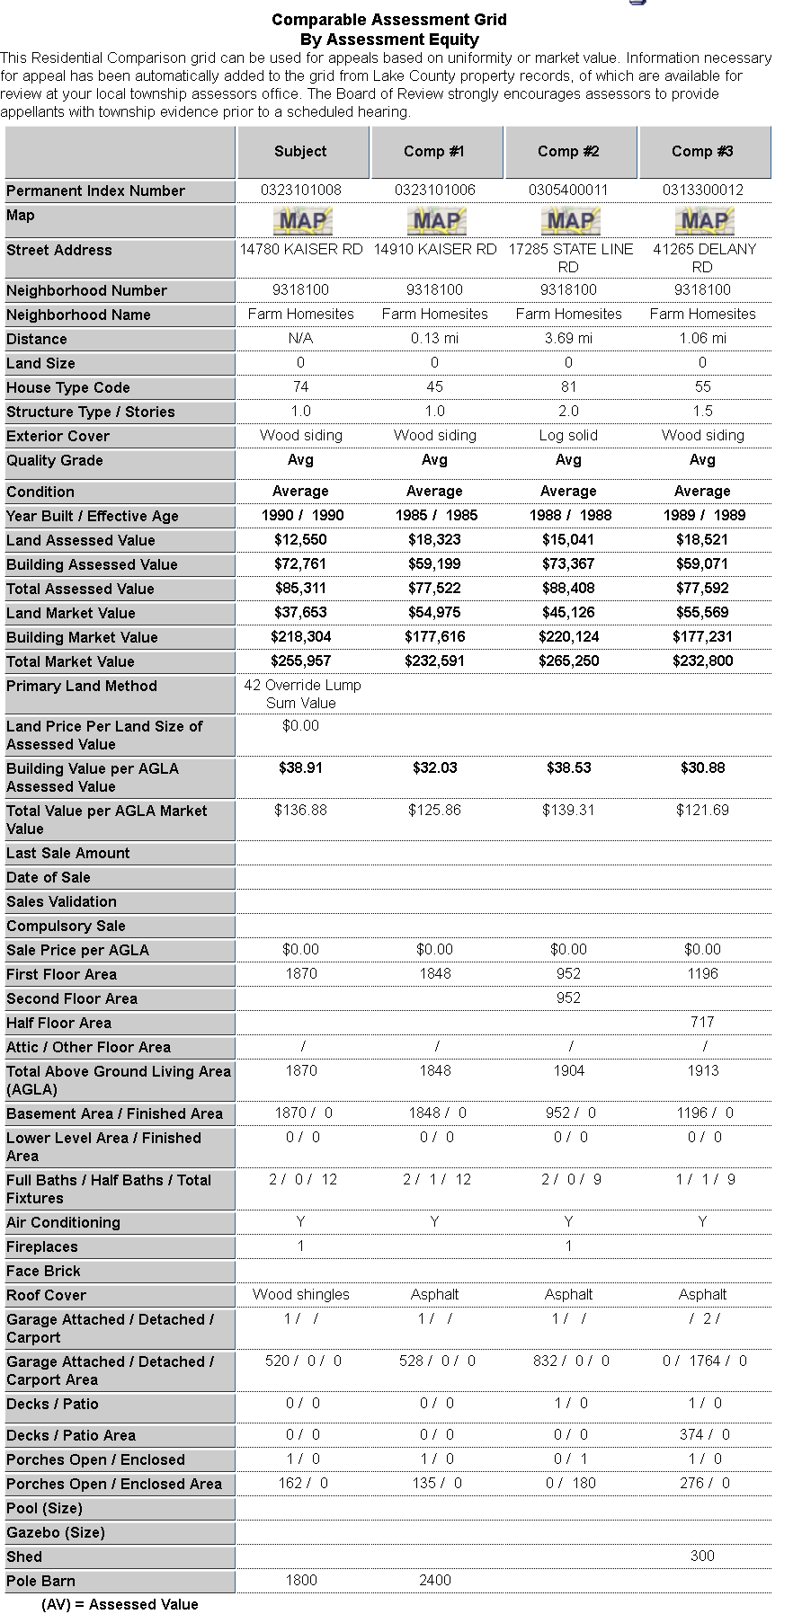
Property Comparison Grid Screen
Field Labels
'permanent_index_number':
'street_address':
'neighborhood_number':
'neighborhood_name':
'land_size':
'house_type_code':
'structure_type_stories':
'exterior_cover':
'quality_grade':
'condition':
'year_built':
'effective_age':
'land_assessed_value':
'building_assessed_value':
'total_assessed_value':
'land_market_value':
'building_market_value':
'total_market_value':
'primary_land_method':
'land_price_per_size_assessed_value':
'building_price_per_agla_assessed_value':
'total_value_per_agla_market_value':
'last_sale_amount':
'date_of_sale':
'sales_validation':
'compulsory_sale':
'sales_price_per_agla':
'first_floor_area':
'second_floor_area':
'half_floor_area':
'attic_area':
'other_floor_area':
'total_above_ground_living_area':
'basement_area':
'basement_finished_area':
'lower_level_area':
'lower_level_finished_area':
'full_baths':
'half_baths':
'total_fixtures':
'air_conditioning':
'fireplaces':
'face_brick':
'roof_cover':
'garage_attached':
'garage_detached':
'carport':
'garage_attached_area':
'garage_detached_area':
'carport_area':
'decks':
'patio':
'deck_area':
'patio_area':
'porches_open':
'porches_enclosed':
'porches_open_area':
'porches_enclosed_area':
'pool':
'gazebo':
'shed':
'pole_barn':
CompGrid.py
CompGrid.py
https://apps03.lakecountyil.gov/comparables/PTAIComp.aspx?' + \
'grid=A&pin=' + subjectpin + '&cmp1pin=' + compPin1 + '&cmp2pin=' +\
compPin2 + '&cmp3pin=' + compPin3
https://apps03.lakecountyil.gov/comparables/PTAIComp.aspx?' + \
'grid=A&pin=' + subjectpin + '&cmp1pin=' + compPin1 + '&cmp2pin=' +\
compPin2 + '&cmp3pin=' + compPin3
Output File: CompPropBySales_Data.txt
Sample Output: (Output from 2 records)
0301300006|43207 DELANY RD|9300118|Farmland w- Bldgs.|322763||||||||1343|2065|3408|4029|6196|10225|42 Override Lump Sum Value|0.00|||||||0.00|0|||||0|0|0|0|0|0|0|0|N|||||||0|0|0|0|0|0|0|0|0|0|0|||||
0301300016|13919 RUSSELL RD|9311100|Rural Zion Area|37462|73|Tri|Wood siding|Avg|Average|1978|1978|15170|48491|63661|45514|145486|191000|9 Per SqFt -Range|0.40|37.44|147.49|||||0.00|1295|||||1295|575|0|600|600|2|0|8|Y|1|440|Asphalt|1|||700|0|0|1|0|256|0|0|0|0|0|||||
Output File: CompPropBySales_Data.txt
Sample Output: (Output from 2 records)
0301300006|43207 DELANY RD|9300118|Farmland w- Bldgs.|322763||||||||1343|2065|3408|4029|6196|10225|42 Override Lump Sum Value|0.00|||||||0.00|0|||||0|0|0|0|0|0|0|0|N|||||||0|0|0|0|0|0|0|0|0|0|0|||||
0301300016|13919 RUSSELL RD|9311100|Rural Zion Area|37462|73|Tri|Wood siding|Avg|Average|1978|1978|15170|48491|63661|45514|145486|191000|9 Per SqFt -Range|0.40|37.44|147.49|||||0.00|1295|||||1295|575|0|600|600|2|0|8|Y|1|440|Asphalt|1|||700|0|0|1|0|256|0|0|0|0|0|||||
Output File: CompGrid_Error.txt
One of the following PIN number is INVALID: [0303400003 : 0303400004 : 0303400005 : Invalid PIN]
One of the following PIN number is INVALID: [0306301005 : 0306301008 : 0306301009 : Invalid PIN]
One of the following PIN number is INVALID: [0306400027 : Invalid PIN : 0307100002 : 0307100006]
Program Execution:
C:\Users\Joe Rytting\Documents\Python Example Code\TaxProject\CompGrid>python CompGrid.py
Working from file: 1000TestPins.txt
2018-08-02 22:30:47.091938
#-------------------------------------------------------------------
# Program Statistics
#-------------------------------------------------------------------
Program execution time in Seconds: 381.263085 Records/Second: 0.38
Records read from File: 1000TestPins.txt : 1000
Records written to Data File: CompGrid_Data.txt : 951
Records written to Error File: CompGrid_Error.txt : 13
Internet Connection Errors : 0

Slide 8
Appendix

Slide 9
Environment Setup
The screen scrapping application was written using Python and few of the open- source web scraping APIs. To set up a PC to run the application ensure that you have the following setup:
Python v3.6.5 (minimum)
validate the version by running “python --version”
To install: https://www.python.org/downloads/
Requests: “pip install -U requests”
There are quite a few libraries in the Python ecosystem that can take care of HTTP for us. To name a few:
Python 3 comes with a built-in module called “urllib,” which can deal with all things HTTP (see https://docs.python.org/3/library/ urllib.html). The module got heavily revised compared to its counterpart in Python 2, where HTTP functionality was split up in both “urllib” and “urllib2” and somewhat cumbersome to work with.
“httplib2” (see https://github.com/httplib2/httplib2): a small, fast HTTP client library. Originally developed by Googler Joe Gregorio, and now community supported.
“urllib3” (see https://urllib3.readthedocs.io/): a powerful HTTP client for Python, used by the requests library below.
“requests” (see http://docs.python-requests.org/): an elegant and simple HTTP library for Python, built “for human beings.”
“grequests” (see https://pypi.python.org/pypi/grequests): which extends requests to deal with asynchronous, concurrent HTTP requests.
“aiohttp” (see http://aiohttp.readthedocs.io/): another library focusing on asynchronous HTTP.
Beautiful Soup: “pip install -U beautifulsoup4”

